Slide 1
ShanghaiTech University
EE 115B: Digital Circuits
Fall 2024
Lecture 6
Hengzhao Yang
October 17, 2024

Slide 2
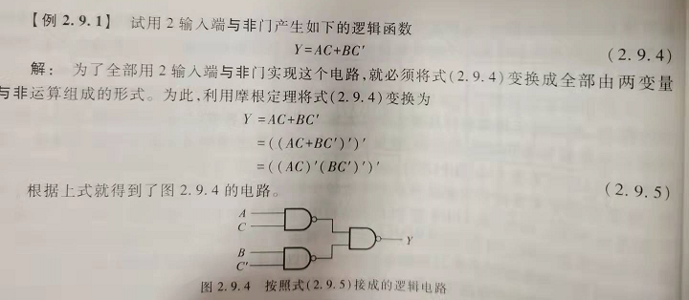
NAND-only logic _______________________________________________
输入端C’应为：C级联NAND

Slide 3
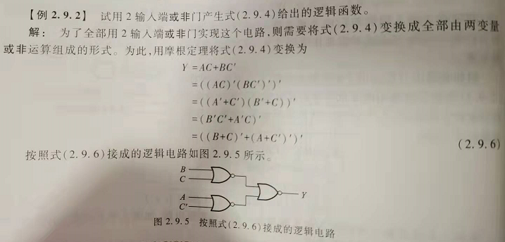
NOR-only logic _______________________________________________
Boolean relationship for steps 3 and 4: AB+A’C+BC=AB+A’C

Slide 4
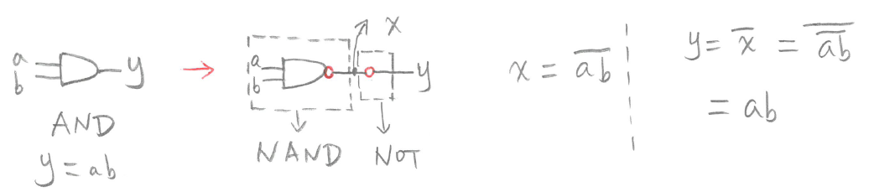
Convert AND to NAND
General rules
  Logic function (circuit functionality) should NOT be changed after conversions
  A bubble means an inverter (NOT)
  Add bubbles in pairs
Convert AND to NAND

Slide 5
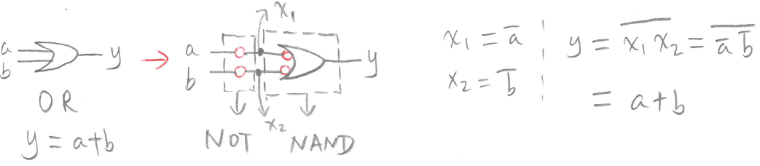
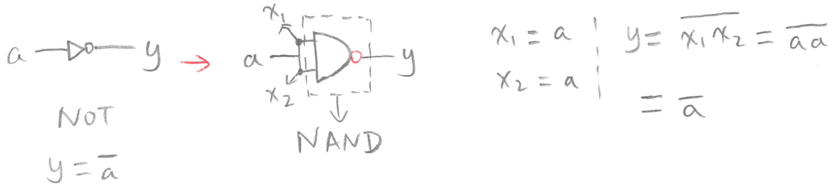
Convert OR/NOT to NAND
Convert OR to NAND
Convert NOT to NAND

Slide 6
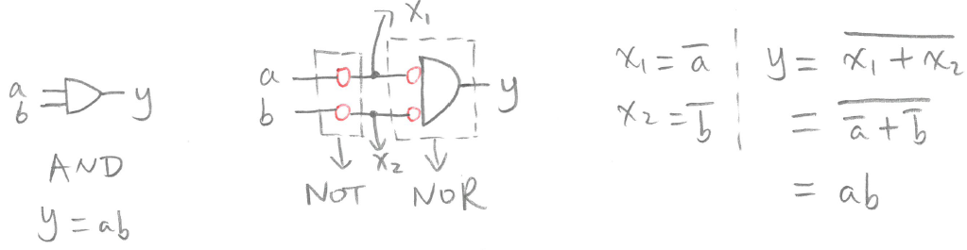
Convert AND to NOR
General rules
  Logic function (circuit functionality) should NOT be changed after conversions
  A bubble means an inverter (NOT)
  Add bubbles in pairs
Convert AND to NOR

Slide 7
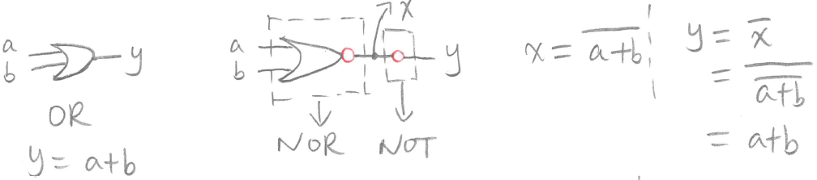
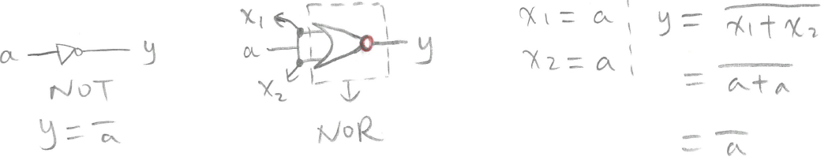
Convert OR/NOT to NOR
Convert OR to NOR
Convert NOT to NOR

Slide 8
Convert circuits with AND/OR/NOT to NAND-only or NOR-only circuits
Convert AND/OR to NAND (NOR if NOR-only) by adding bubbles
If necessary, add bubbles to keep logic function unchanged
Convert single bubbles to NAND/NOR

Slide 9
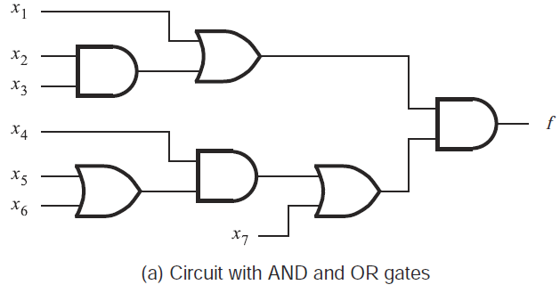
NAND-only
Example

Slide 10
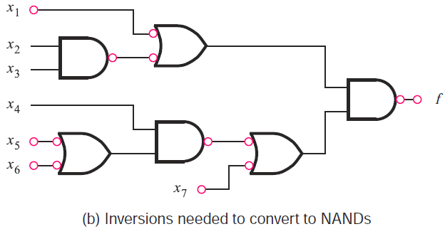
NAND-only
Convert AND/OR to NAND, add bubbles

Slide 11
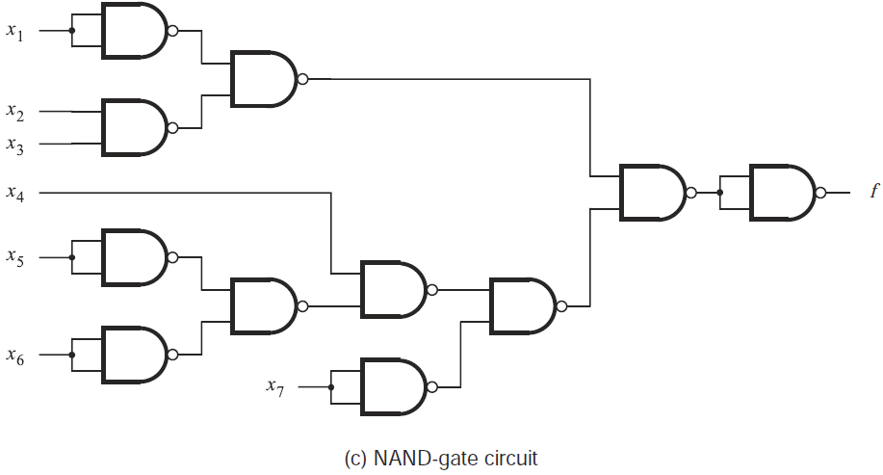
NAND-only
Convert single bubbles to NAND

Slide 12
NOR-only
Example

Slide 13
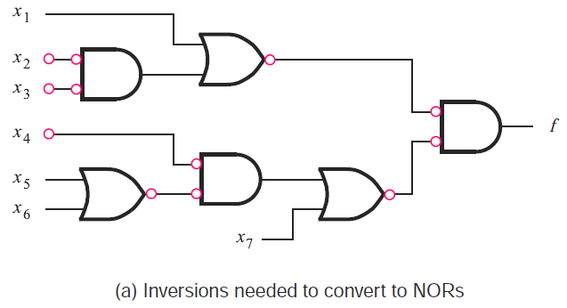
NOR-only
Convert AND/OR to NOR, add bubbles

Slide 14
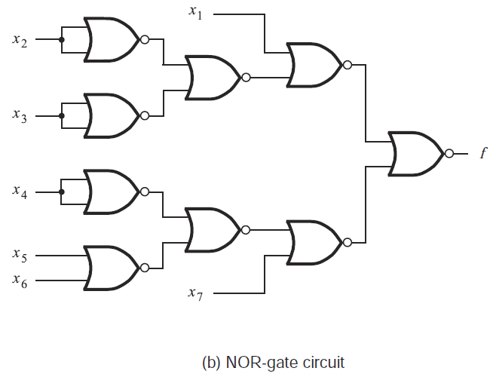
NOR-only
Convert single bubbles to NOR

Slide 15
4.1 概述
一、组合逻辑电路的特点
从功能上
从电路结构上
任意时刻的输出仅
取决于该时刻的输入
不含记忆（存储）元件

Slide 16






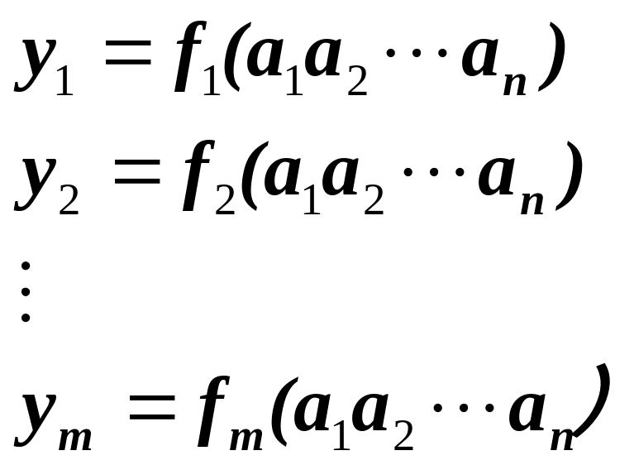
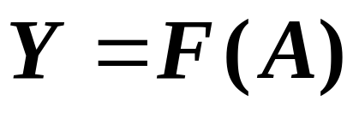
二、逻辑功能的描述
组合逻辑 电路
组合逻辑电路的框图

Slide 17
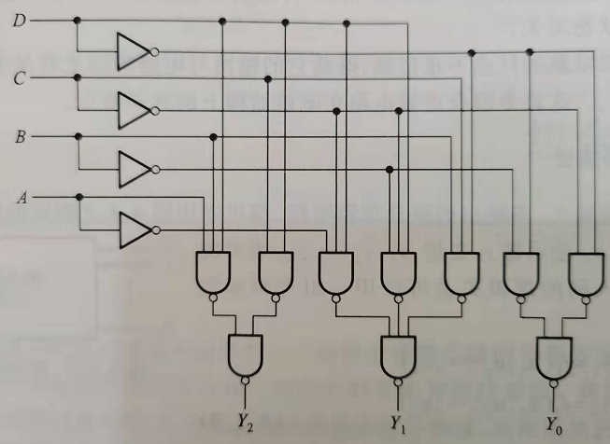
4.2 组合逻辑电路的分析方法
Example: Analyze the circuit functionality.

Slide 18
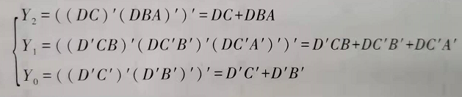
Solution
Output function

Slide 19
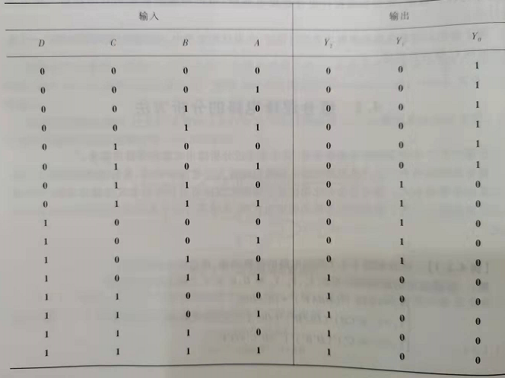
Solution
Truth table
(DCBA)₂=X₁₀
  0<=X<=5, Y₀=1
  6<=X<=10, Y₁=1
  11<=X<=15, Y₂=1
Circuit is used to determine the input range.

Slide 20
4.3 组合逻辑电路的设计方法
一、逻辑抽象
分析因果关系，确定输入/输出变量
定义逻辑状态的含意（赋值）
列出真值表
二、写出逻辑函数式
三、选定器件类型
四、根据所选器件：对逻辑式化简（用门电路）
变换（用MSI）
或进行相应的描述（PLD）
五、画出逻辑电路图，或下载到PLD
六、设计验证
七、工艺设计

Slide 21
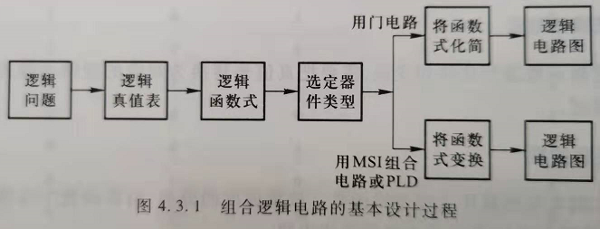
Design flow

Slide 22
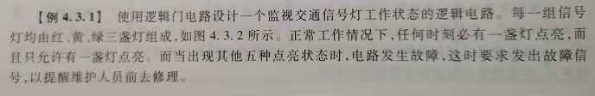
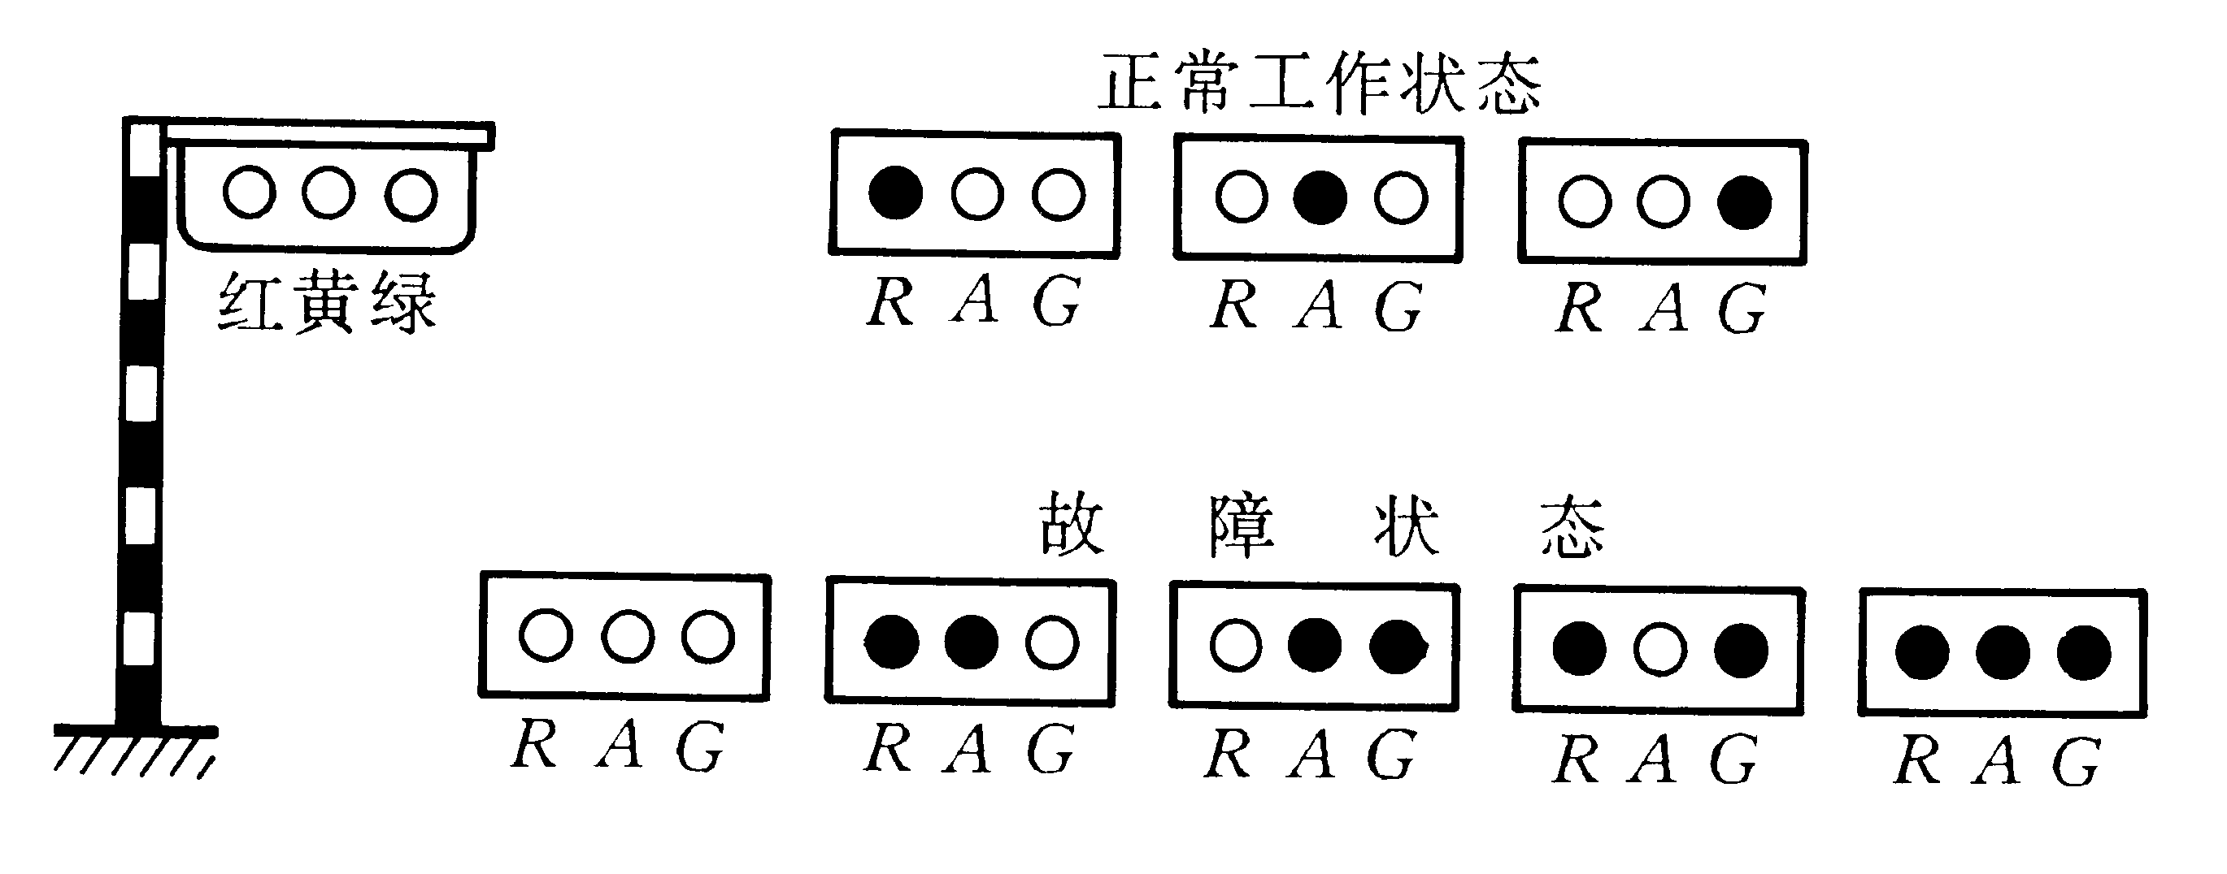
设计举例：

Slide 23
设计举例：
输入变量 |  |  | 输出
R | A | G | Z
0 | 0 | 0 | 1
0 | 0 | 1 | 0
0 | 1 | 0 | 0
0 | 1 | 1 | 1
1 | 0 | 0 | 0
1 | 0 | 1 | 1
1 | 1 | 0 | 1
1 | 1 | 1 | 1
1. 逻辑抽象
输入变量:
红（R）、黄（A）、绿（G）
输出变量：
故障信号（Z）
2. 写出逻辑函数式
R
如果信号灯
出现故障，
Z为1
A
Z
G

Slide 24
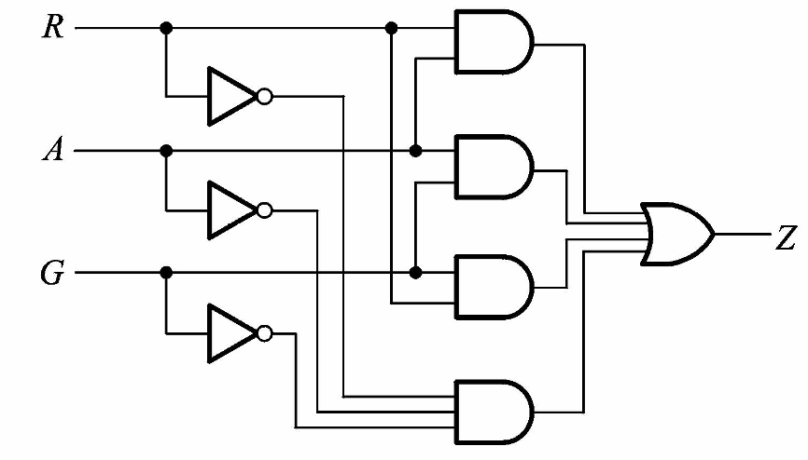
设计举例：
3. 选用小规模集成门电路
4. 函数化简/转换（1: AND-OR implementation）
5. 画出电路图

Slide 25

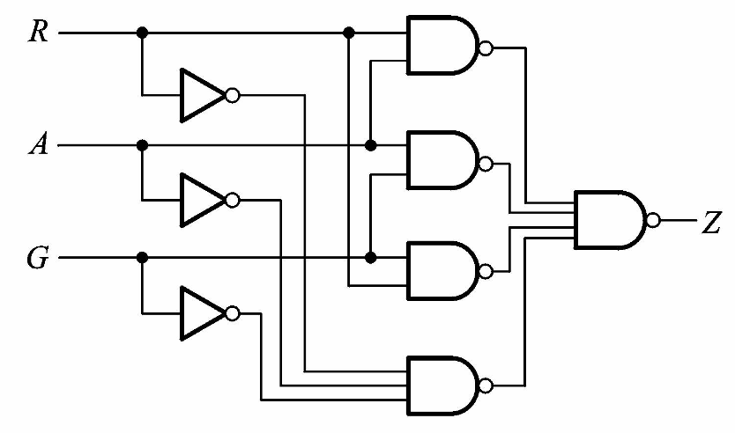
2: NAND implementation
4. 函数化简/转换 (based on AND-OR)
5. 画出电路图
三个NOT应为NAND

Slide 26
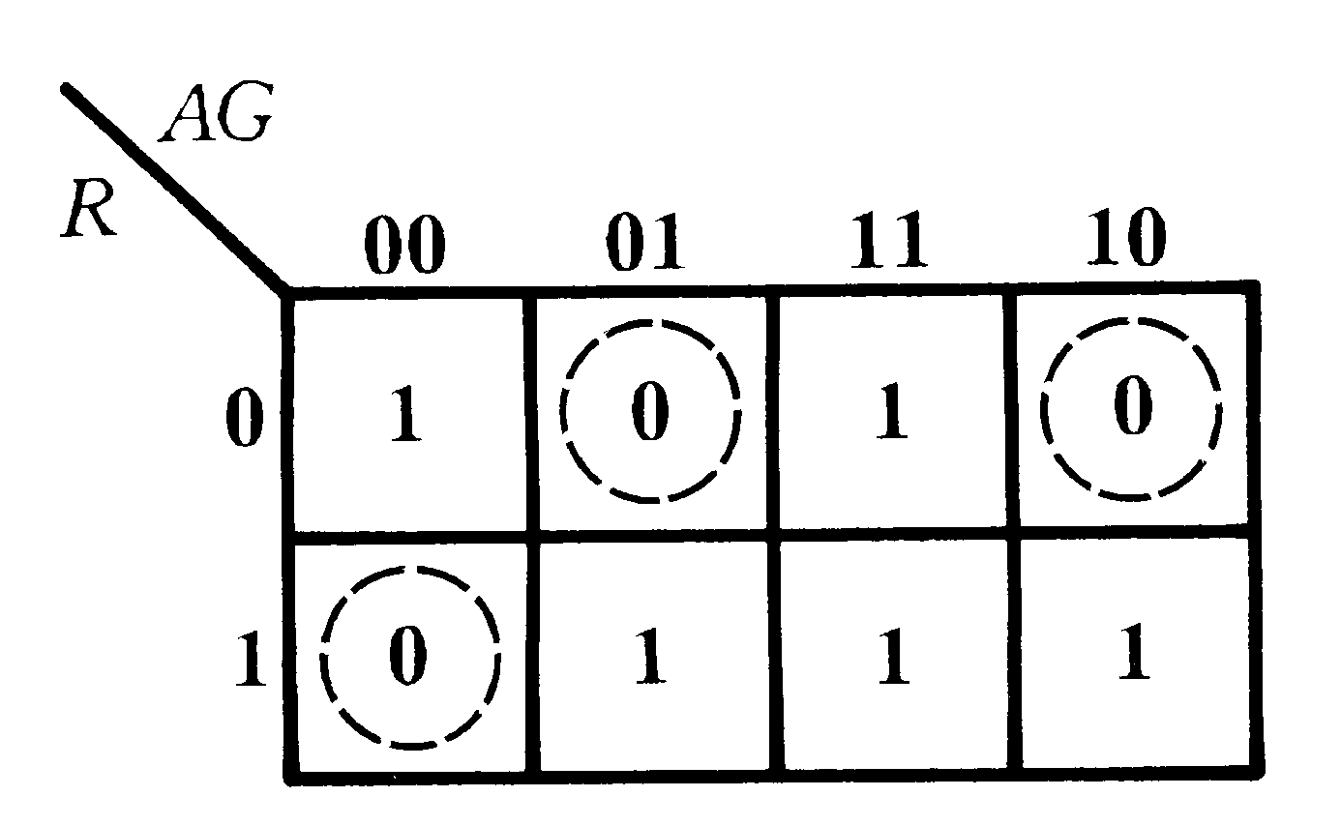

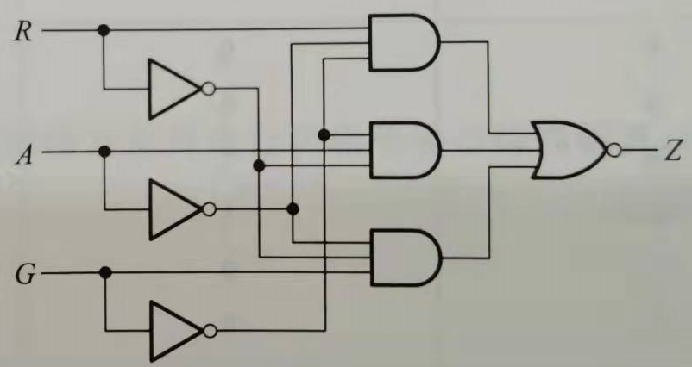
3: AND-OR-Invert (AOI) implementation
函数化简/转换
  Combine 0’s to get minimum SOP for Z’
  Invert Z’ to get Z
5. 画出电路图
最后一级：NOR应为OR和NOT级联

Slide 27
4: NOR implementation
函数化简/转换 (based on AOI)
  Z=(RA’G’+R’AG’+R’A’G)’
  =[(R’+A+G)’+(R+A’+G)’+(R+A+G’)’]’
  （Alternative solution：combine 0’s to get minimum POS for Z, then apply DeMorgan’s theorem）
Summary
SOP: Corresponding to 1’s in k-map, AND-OR and NAND implementations
POS: Corresponding to 0’s in k-map, AND-OR-Invert (AOI) and NOR implementations

